Slide 1

CSS Basics
SoftUni Team
Technical Trainers
Software University
http://softuni.bg

Slide 2
Table of Contents
What is CSS?
CSS in HTML document
Selectors
Block Еlements
Box Мodel
Fonts
Comments in CSS

Slide 3
Questions?
sli.do
#tech-common

Slide 4
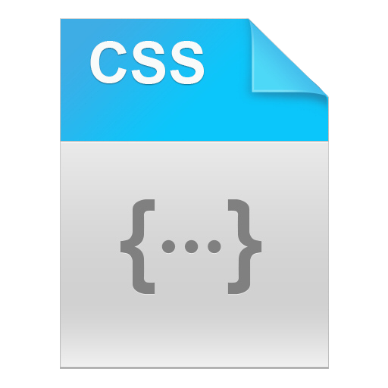
CSS
Cascading Style Sheets

Slide 5
Definition
CSS (Cascading Style Sheets) is the code used to design the HTML documents
An addition to the HTML
Designed to enable the separation of presentation and content, including layout, colors, and fonts
Not a programming language
Text file with .css extension

Slide 6
Syntax
A CSS rule-set consists of a selector and a declaration block
The selector points to the HTML element you want to style
The declaration block contains one or more declarations separated by semicolons
Selector
p {
color: red;
}
color: red;
Declaration
Property
Value
Declaration block

Slide 7
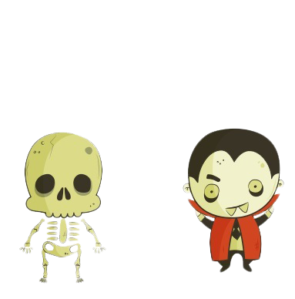
HTML (+) CSS
CSS and HTML
How They Communicate

Slide 8
CSS Connection with HTML
When a browser reads a style sheet, it will format the HTML document according to the information in the style sheet
There are three ways to insert CSS (style sheet):
Inline
Internal
External

Slide 9
Inline Style
An inline style may be used to apply a unique style for a single element
To use inline styles, add the style attribute to the relevant element
The style attribute can contain any CSS property
Style attribute
Style rules separated with ";"
" ; "
<h1 style="color:blue;margin-left:30px;">This is a heading</h1>
property
value

Slide 10
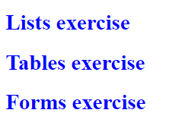
Problem: Heading Stage Upgrade
Use your HTML code from the previous lecture
Make your headings (h1) inline with color blue
Solution:
<h1 style="color: blue">Lists exercise</h1>
<h1 style="color: blue">Tables exercise</h1>
<h1 style="color: blue">Forms exercise</h1>

Slide 11
Internal Style
An internal style sheet may be used if one single page has a unique style
Internal styles are defined within the <style> element, inside the <head> section of an HTML page
Style element
<head>
<style>
body {
background-color: linen;
}
</style>
</head>
property
value
selector
Must be closed

Slide 12
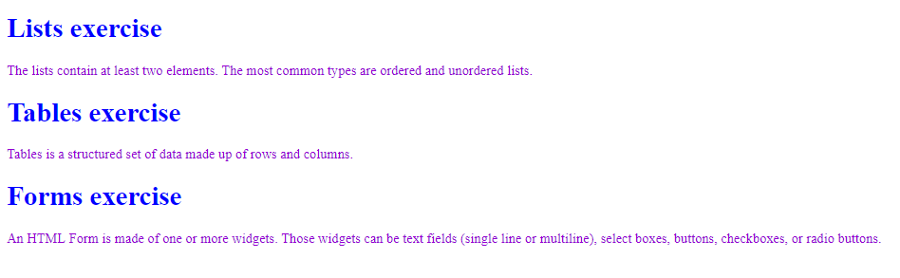
Problem: Paragraph Stage Upgrade
Use your HTML code from the previous lecture
Make all paragraphs with internal style with color darkviolet

Slide 13
Solution: Paragraph Stage Upgrade
Make Internal style in the HTML document and style all <p>
<head>
<meta charset="UTF-8">
<title>CSS-Lab</title>
<style>
p {
color: darkviolet;
}
</style>
</head>
</html>

Slide 14
External Style
You can change the look of an entire website by changing just one file!
Time saver when you want to have the same element in all of your pages
Each page must include a reference to the external style sheet file inside the <link> element. The <link> element goes inside the <head> section

Slide 15
External style example
using-css.html
styles.css
<!DOCTYPE html>
<html>
<head>
<link rel="stylesheet" type="text/css" href="styles.css">
</head>
<body id="content"> <p>This is a <span class="special"> special beer</span> for <span class= "special">special drinkers</span>.</p>
</body>
</html>
.special {
font-style: italic;
font-weight: bold;
color: blue;
}
#content {
background: #EEE;
}
p {
font-size: 24pt;
}

Slide 16
Problem: Code Refactor
Delete all the styles you have made
Open the styles from the HTML lecture
Link the CSS file into your HTML file
Add in the CSS file, the styles you have deleted
<head>
<meta charset="UTF-8">
<title>CSS-Lab</title>
<link rel="stylesheet" type="text/css" href="style.css"/>
</head>
h1 {
text-align: center;
color: blue;
}
p {
// TODO }

Slide 17
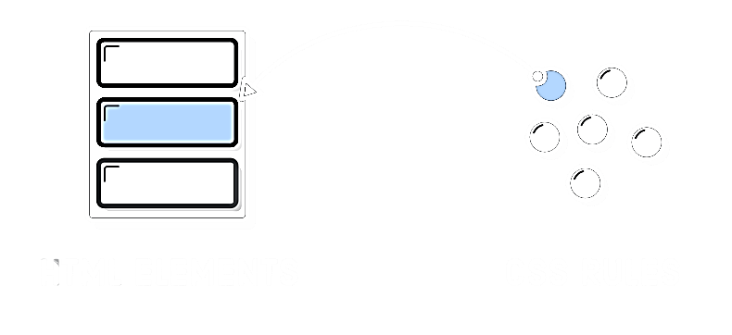
"Selector"
CSS Selectors
Class, Id, Tag, "*"

Slide 18
Selectors
In CSS, selectors are patterns used to select the element(s) you want to style
Types of selectors:
Primary – define the elements to which a set of CSS rules apply
Nested Selectors - more than one simple selector
Pseudo Selectors - relative to element content or state

Slide 19

Primary Selectors
Select by:
tag - selects all specified tags
#id - selects a unique element by ID
.class - selects a group of elements with the specified class
* - selects everything

Slide 20
Example
using-css.html
styles.css
<!DOCTYPE html>
<html>
<head>
<link rel="stylesheet" type="text/css" href="styles.css">
</head>
<body id="content"> <p>This is a <span class="special"> special beer</span> for <span class= "special">special drinkers</span>.</p>
</body>
</html>
#content {
background: #EEE;
}
.special {
font-style: italic;
font-weight: bold;
color: blue;
}
p {
font-size: 24px;
}
* {
border: 0;
}

Slide 21

Block Elements
Block, Inline, Inline-Block

Slide 22
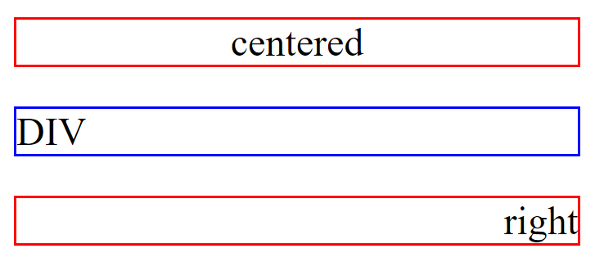
Block Elements
A block-level element always starts on a new line and takes up the full width available
<div> and <p> are block elements
Fill the entire container width
Stack vertically one after another

Slide 23
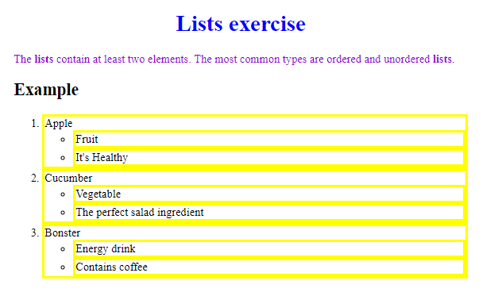
Problem: List/Table/Form Stage Upgrade
Use your HTML code from the previous lecture
Make all list elements (<li>) with solid border in yellow color

Slide 24


Inline Elements
An inline element does not start on a new line and only takes up as much width as necessary
<span> is inline element
Its shape is not always rectangular
Can be split across multiple lines

Slide 25
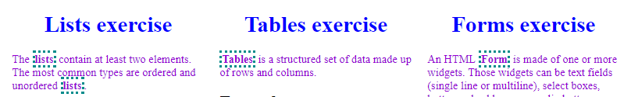
Problem: List/Table/Form Stage Upgrade
Use your HTML code from the previous lecture
Make all your spans with dotted border in darkcyan color

Slide 26
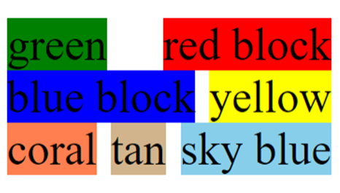
Inline-Block Elements
Inline-block elements are similar to inline elements, except they can have padding and margins added on all four sides
Rectangles arranged one after another
Just like words in a sentence

Slide 27
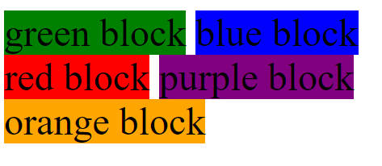
Problem: Color Blocks
Example:
Use the following HTML
<body>
<div id="green">green block</div>
<div id="blue">blue block</div>
<div id="red">red block</div>
<div id="purple">purple block</div>
<div id="orange">orange block</div>
</body>

Slide 28
Solution: Color Blocks
Make external CSS file, link it in your HTML <head>
Make all <div> with display: inline-block
Call every <div> by its id name and set its background-color to its name's corresponding color
div {
display: inline-block;
}
#green {
background-color: green;
} // TODO make the rest

Slide 29
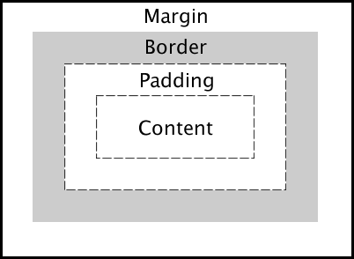
Box Model
Margins, Border, Padding, Content

Slide 30



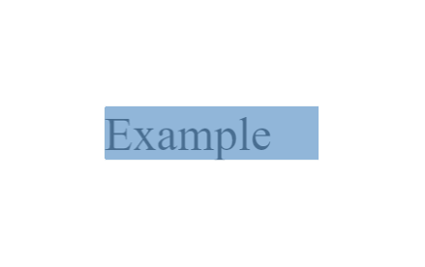
Box Model
The CSS box model is essentially a box that wraps around every HTML element
It consists of:
Margins - Area outside the border. It is transparent
Borders - Border that goes around the padding and content
Padding - Area around the content It is transparent
Content - Where text and images appear

Slide 31
Example
The CSS border properties allow you to specify the style, width, and color of an element's border
top
right
bottom
left
<div class="margin" style="margin: 20px 20px 20px 20px">
<div class="border" style="border: solid red">
<div class="padding" style="padding: 10px 10px">
<div>My content is here</div>
</div>
</div>
</div>
Top and bottom
Left and right

Slide 32
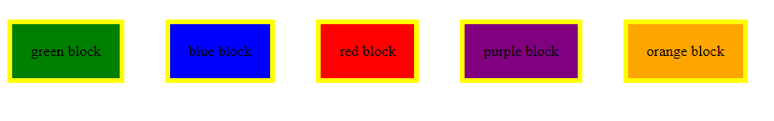
Problem: Color Blocks Upgrade
Use the HTML and CSS from the previous problem
Make all <div> padding 20px on each side, refresh the browser
Set 3px solid, border with yellow color, refresh the browser
Now set margin with 20px for each side, refresh the browser

Slide 33
Solution: Color Blocks Upgrade
We have the <div> display and color already
Set the padding and margin. In this case we have 20px on each side, so we can just set them to a single number and it will be applied for all sides
If you forget to tell what kind of border you want (in this case "solid"), it will not be displayed at all
div {
display: inline-block;
padding: 20px;
border: 3px solid yellow;
margin: 20px;
}

Slide 34



F12
Ctrl+Shift+I
Ctrl+Shift+K
Dev Tools

Slide 35
Dev Tools
We will view the following more important tabs in dev tools:
Elements – show our HTML structure
Styles – show our CSS code for the current page
We can change our HTML and CSS code by double clicking the element
By hovering over the elements we can see their margins, padding and content

Slide 36
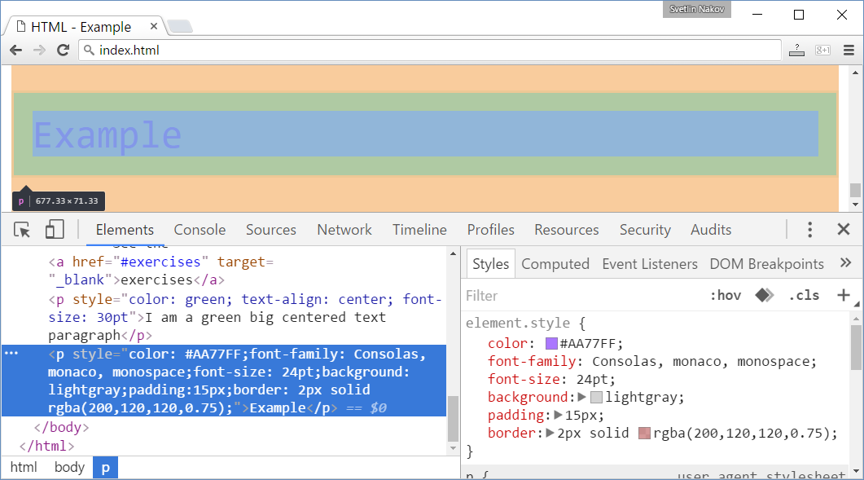
Google Chrome Dev Tools Example

Slide 37
F
F
F
F
F
F
F
F
F
F
F
Fonts
Font-Family, Size, Colors

Slide 38
Font-Families
In CSS, there are two types of font family names:
generic family - a group of font families with a similar look
font family - a specific font family
Generic family | Font family | Description
Serif | Times New Roman Georgia | Have small lines at the ends on some characters
Sans-serif | Arial Verdana | Do not have the lines at the ends of characters
Monospace | Courier New Lucida Console | All characters have the same width

Slide 39
Font-Family Declaration
The font family of a text is set with the font-family property
The font-family property should hold several font names as a "fallback" system
End with a generic family, to let the browser pick a similar font in the generic family, if no other fonts are available
Property
Font name 1
Font name 2
Generic family
p {
font-family: "Times New Roman", Times, serif;
}

Slide 40
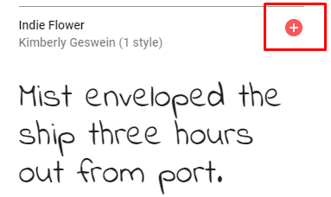

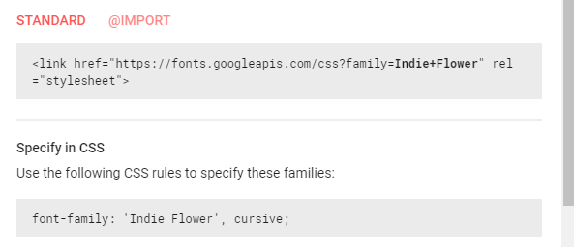
Problem: Cool Fonts
Use the code from the previous problem
Go to https://fonts.google.com/
Pick a font of your preference
Click on the "+" in the top-right corner
Click here
Copy the link in your HTML <head>
Copy the font family in your <div>

Slide 41
Solution: Cool Fonts
HTML file
CSS file
<head>
<meta charset="UTF-8">
<title>CSS-Lab</title>
<link href="https://fonts.googleapis.com/css?family=Indie+Flower" rel="stylesheet">
<link rel="stylesheet" type="text/css" href="style.css"/>
</head>
div {
display: inline-block;
color: white;
padding: 20px;
border: 3px solid yellow;
margin: 20px;
font-family: 'Indie Flower', cursive;
}

Slide 42
Font Size
The font-size property sets the size of the text
The font-size value can be an absolute, or relative size
Absolute size | Relative size
Sets the text to a specified size | Sets the size relative to surrounding elements
The user cannot change the text size in all browsers | The user can change the text size in browsers
Useful when the physical size of the output is known

Slide 43
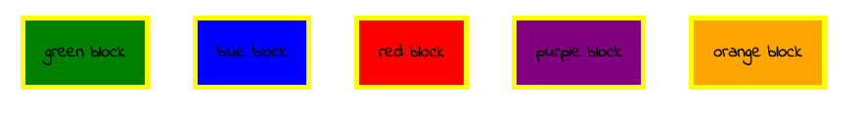
Problem: Cool Fonts Upgrade
Use the code from the previous problem
Set large font-size
Set bold font-weight

Slide 44
Font Colors
The color property is used to set the color of the text
The color is specified by:
a color name - like "red"
a HEX value - like "#ff0000"
an RGB value - like "rgb(255,0,0)"
h1 {
color: red;
color: #FF0000;
color: rgb(255, 0, 0);
}

Slide 45

Problem: Cool Fonts Upgrade
Use the code from the previous problem
In your <div> set white color

Slide 46
/**/
Comments in CSS

Slide 47
Writing Comments
The text inside the /* */ marks is CSS comment
This allows you to enter notes into CSS that will not be interpreted
The first instance of */ that follows an instance of /* closes the comment
Can be multiline
Example:
body {
background-color: blue;
/* maybe lighter
color? */
}

Slide 48

Summary
…
…
…
What is CSS?
CSS in HTML
Selectors
Fonts
Box Model
Block Elements

Slide 49
https://softuni.bg/courses/technology-fundamentals

Slide 50













SoftUni Diamond Partners

Slide 51




SoftUni Organizational Partners

Slide 52




Trainings @ Software University (SoftUni)
Software University – High-Quality Education and Employment Opportunities
softuni.bg
Software University Foundation
http://softuni.foundation/
Software University @ Facebook
facebook.com/SoftwareUniversity
Software University Forums
forum.softuni.bg

Slide 53

License
This course (slides, examples, demos, videos, homework, etc.) is licensed under the "Creative Commons Attribution-NonCommercial-ShareAlike 4.0 International" license

